Slide 1
Password Security
Never store a password as plain text
2 techniques
Notes:
Practical 11.1

Slide 2
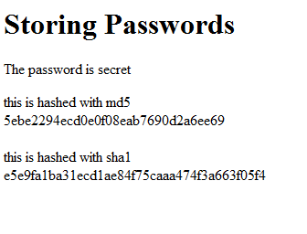
Hash algorithms
In PHP there are two popular hash algorithms for you to use: md5() and sha1().
echo(md5(‘secret’));
echo(sha1(‘secret’));

Slide 3
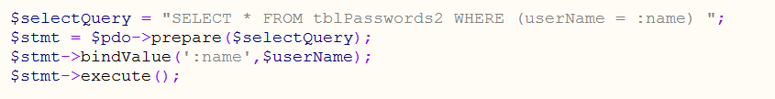
Username security
Always clean data coming off a form Always use prepared statements for the query string
$userName = strip_tags($_POST['userName']);

Slide 4
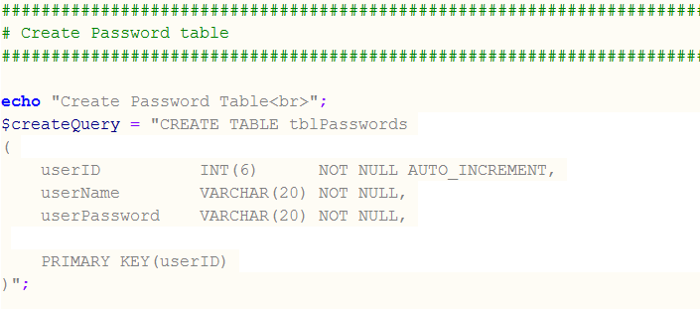
Storing the password
$2a$10$6cdsxxinOA9U1rg4R5mAQOhejKZjCtnKyjZC6BgM9/WGIxSXjUed2
Use VARCHAR(100)
too small

Slide 5
Unique user names
Sacrifice field and table readability for security
CREATE TABLE t1 (
col1 INT NOT NULL,
col2 DATE NOT NULL,
col3 VARCHAR(25) NOT NULL,
col4 INT NOT NULL,
UNIQUE KEY (col3)
)

Slide 6
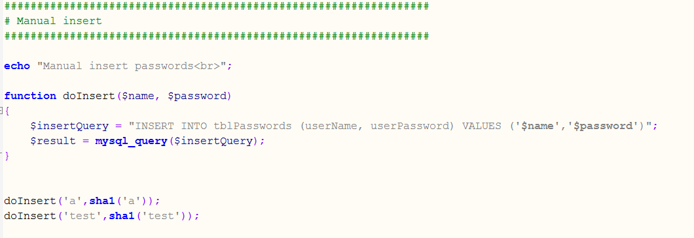
Insert into table hashed and salted
Hashing only must salt as well!

Slide 7
Hash Collision
A hash "collision" occurs when two different data inputs generate the same resulting hash. The likelihood of this happening depends on which function you use.
Potentially a person could generate the hashed password with a different starting string and log in with that string.

Slide 8
Rainbow Tables
A rainbow table is built by calculating the hash values of commonly used words and their combinations.
These tables can have as many as millions or even billions of rows.
The rainbow table is searched for each hashed password-easy passwords will be found.
There are rainbow tables for sha1 and md5.

Slide 9
Salt your passwords
A salt is a bunch of random characters, this is added to each password and then the password is hashed.
Even better have a different salt for each user.

Slide 10
Hash speed
Imagine that you use a hash function that can only run 1 million times per second on the same hardware, instead of 1 billion times per second. It would then take the attacker 1000 times longer to brute force a hash.
One way to do this is to use an algorithm that supports a "cost parameter," such as BLOWFISH. In PHP, this can be done using the crypt() function.
// the salt for blowfish should be 22 characters long
$hash= crypt($password, '$2a$10$'.$unique_salt);
The first value is '$2a', which indicates that we will be using the BLOWFISH algorithm.
The second value, '$10' in this case, is the "cost parameter". This is the base-2 logarithm of how many iterations it will run (10 => 2^10 = 1024 iterations.) This number can range between 04 and 31.

Slide 11
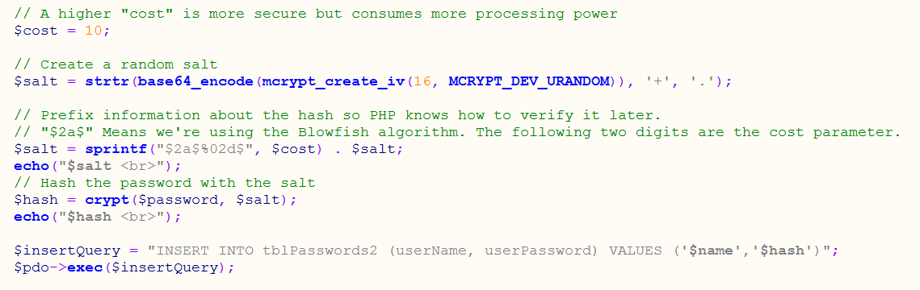
Code to hash and salt

Slide 12
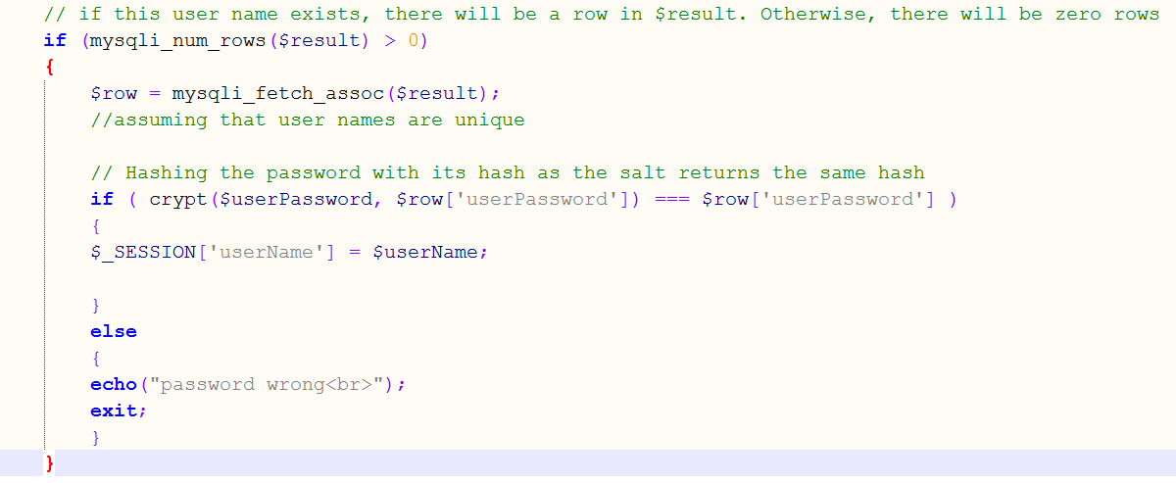
How to check a password
Plain text
Hashed password

Slide 13
Don’t store the text password in session
If the username is in session you don’t need to store the password

Slide 14
Reading
http://code.tutsplus.com/tutorials/understanding-hash-functions-and-keeping-passwords-safe--net-17577
http://alias.io/2010/01/store-passwords-safely-with-php-and-mysql/
http://www.sitepoint.com/password-hashing-in-php/

